Slide 1
Visual impairment simulation workshop
Airedale NHS Foundation Trust Inservice, 26th October 2023
Presented by: Michael Cheung and Leigh Mortimer
Notes:
Visual impairment simulation workshop

Slide 2

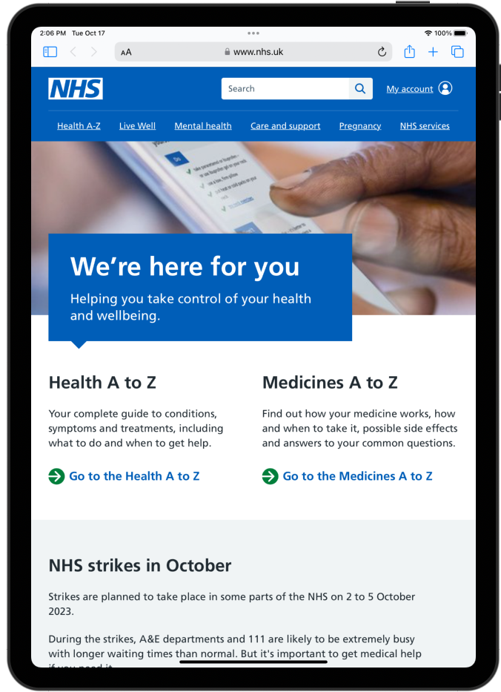
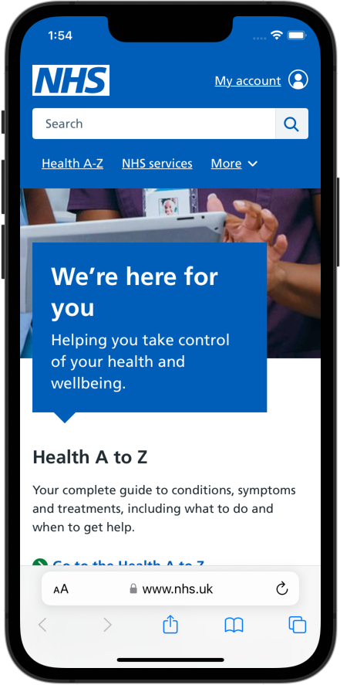
Introduction
We are Michael and Leigh
We work on the NHS.UK website
We work at making it accessible
Notes:
I’m a senior web developer and Leigh is a lead product manager for accessibility
We work for NHS England, in the product delivery directorate, specifically on the NHS.UK website
Among other things to do with accessibility, we help run accessibility sessions within our organization to make people more aware of accessibility issues that might affect people who use our website.

Slide 3
Web accessibility
Making the website work for everyone, regardless of ability
Notes:
What do we mean by making the site accessible?
Making it easy to use, regardless of ability. So, for example, making it work for people with disabilities, whether that be long term or temporary or situational

Slide 4
Why this matters
We want people to access our content regardless of their situation or disability, using any type of technology to do so.
We want to reduce any barriers in accessing our services online and users to not rely on others.
We reach out to a range of support groups, disabled groups and charities, to test and use our products to ensure they work for as many people as possible.
It is the law.
Notes:
Want to challenge the idea that if you have a disability, or are recovering from say a stroke, it shouldn’t be someone else that needs to help you do the things you normally do online. You should be able to do it yourself regardless of your circumstances.
We also have to meet legal requirements - Equality Act 2010, and for us the Public Sector Bodies Accessibility Regulations which apply to websites and mobile apps.

Slide 5

The NHS Constitution for England
Principle 1
The NHS provides a comprehensive service, available to all
It is available to all irrespective of gender, race, disability, age, sexual orientation, religion, belief, gender reassignment, pregnancy and maternity or marital or civil partnership status.
Notes:
A reminder of the NHS constitution
A set of principles and values on which the NHS was founded.
The first principle states that ”The NHS provides a comprehensive service, available to all”
This applies to us as well, in the digital space.

Slide 6
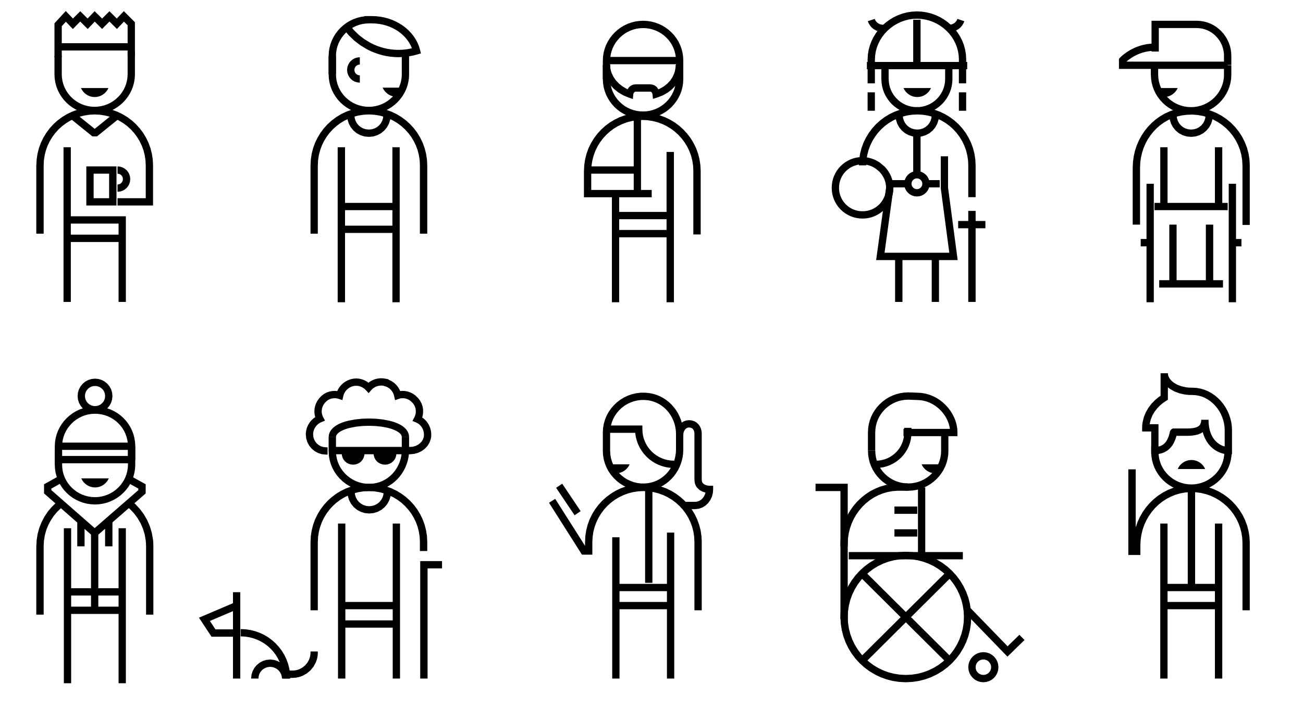
Disabilities
Auditory
Cognitive
Neurological
Physical
Speech
Visual
Notes:
When we are talking about disabilities, here is a list of some disabilities that we need to consider when looking at web accessibility,
all of which you will be aware of.

Slide 7
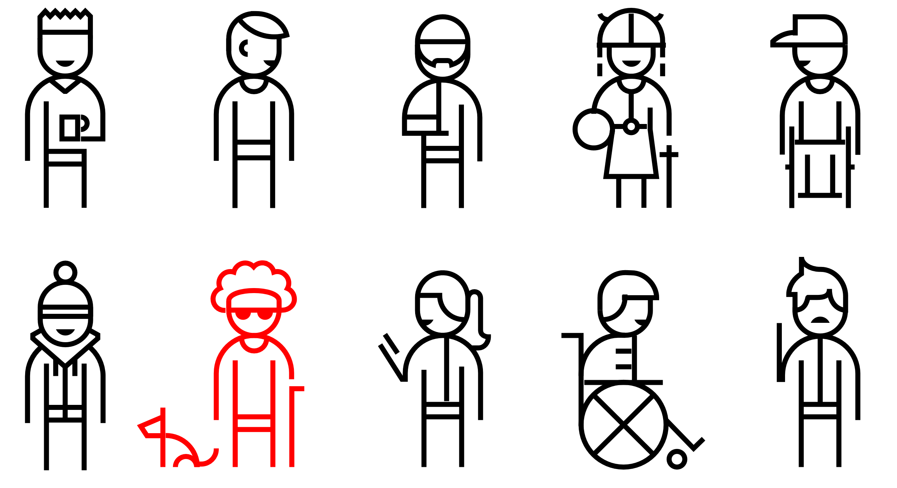
Disabilities
Auditory
Cognitive
Neurological
Physical
Speech
Visual
Notes:
What we are interested in today is visual

Slide 8

“More than two million people
are estimated to be living with
sight loss in the UK”
Royal National Institute
of Blind People
Notes:
Here’s a statistic…
This sight loss is severe enough to have a significant impact on their daily lives.
340,000 people are registered blind or partially sighted.

Slide 9
Main causes of blindness and sight loss in adults
Age-related macular degeneration
Cataracts
Diabetic retinopathy
Glaucoma

Slide 10
Age-related macular degeneration (AMD)
A common condition that affects the middle part of your vision
Usually first affects people in their 50s and 60s
It does not cause total blindness, but can make everyday activities like reading and recognising faces difficult
Without treatment, your vision may get worse. This can happen gradually over several years (”dry AMD”) or quickly over a few weeks or months (“wet AMD”)
The exact causes are unknown. It has been linked to smoking, high blood pressure, being overweight and having a family history of AMD

Slide 11
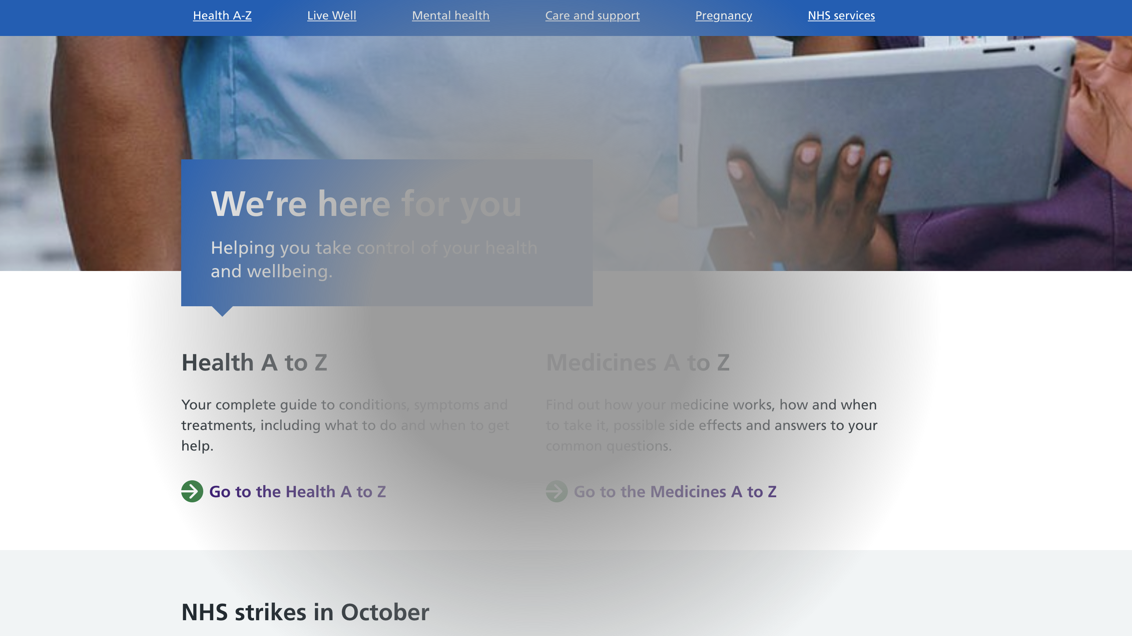
Image showing what AMD might look like
Notes:
Affects the middle part of your vision

Slide 12
Cataracts
Cataracts are when the lens develops cloudy patches
Over time these patches usually become bigger causing blurry, misty vision and eventually blindness
When we’re young, our lenses are like clear glass that we can see through. As we get old, they become frosted, like bathroom glass, and begin to limit our vision
Cataracts usually appear in both eyes. They may not necessarily develop at the same time or be the same in each eye.
They are more common in older adults and can affect your ability to carry out daily tasks such as driving

Slide 13
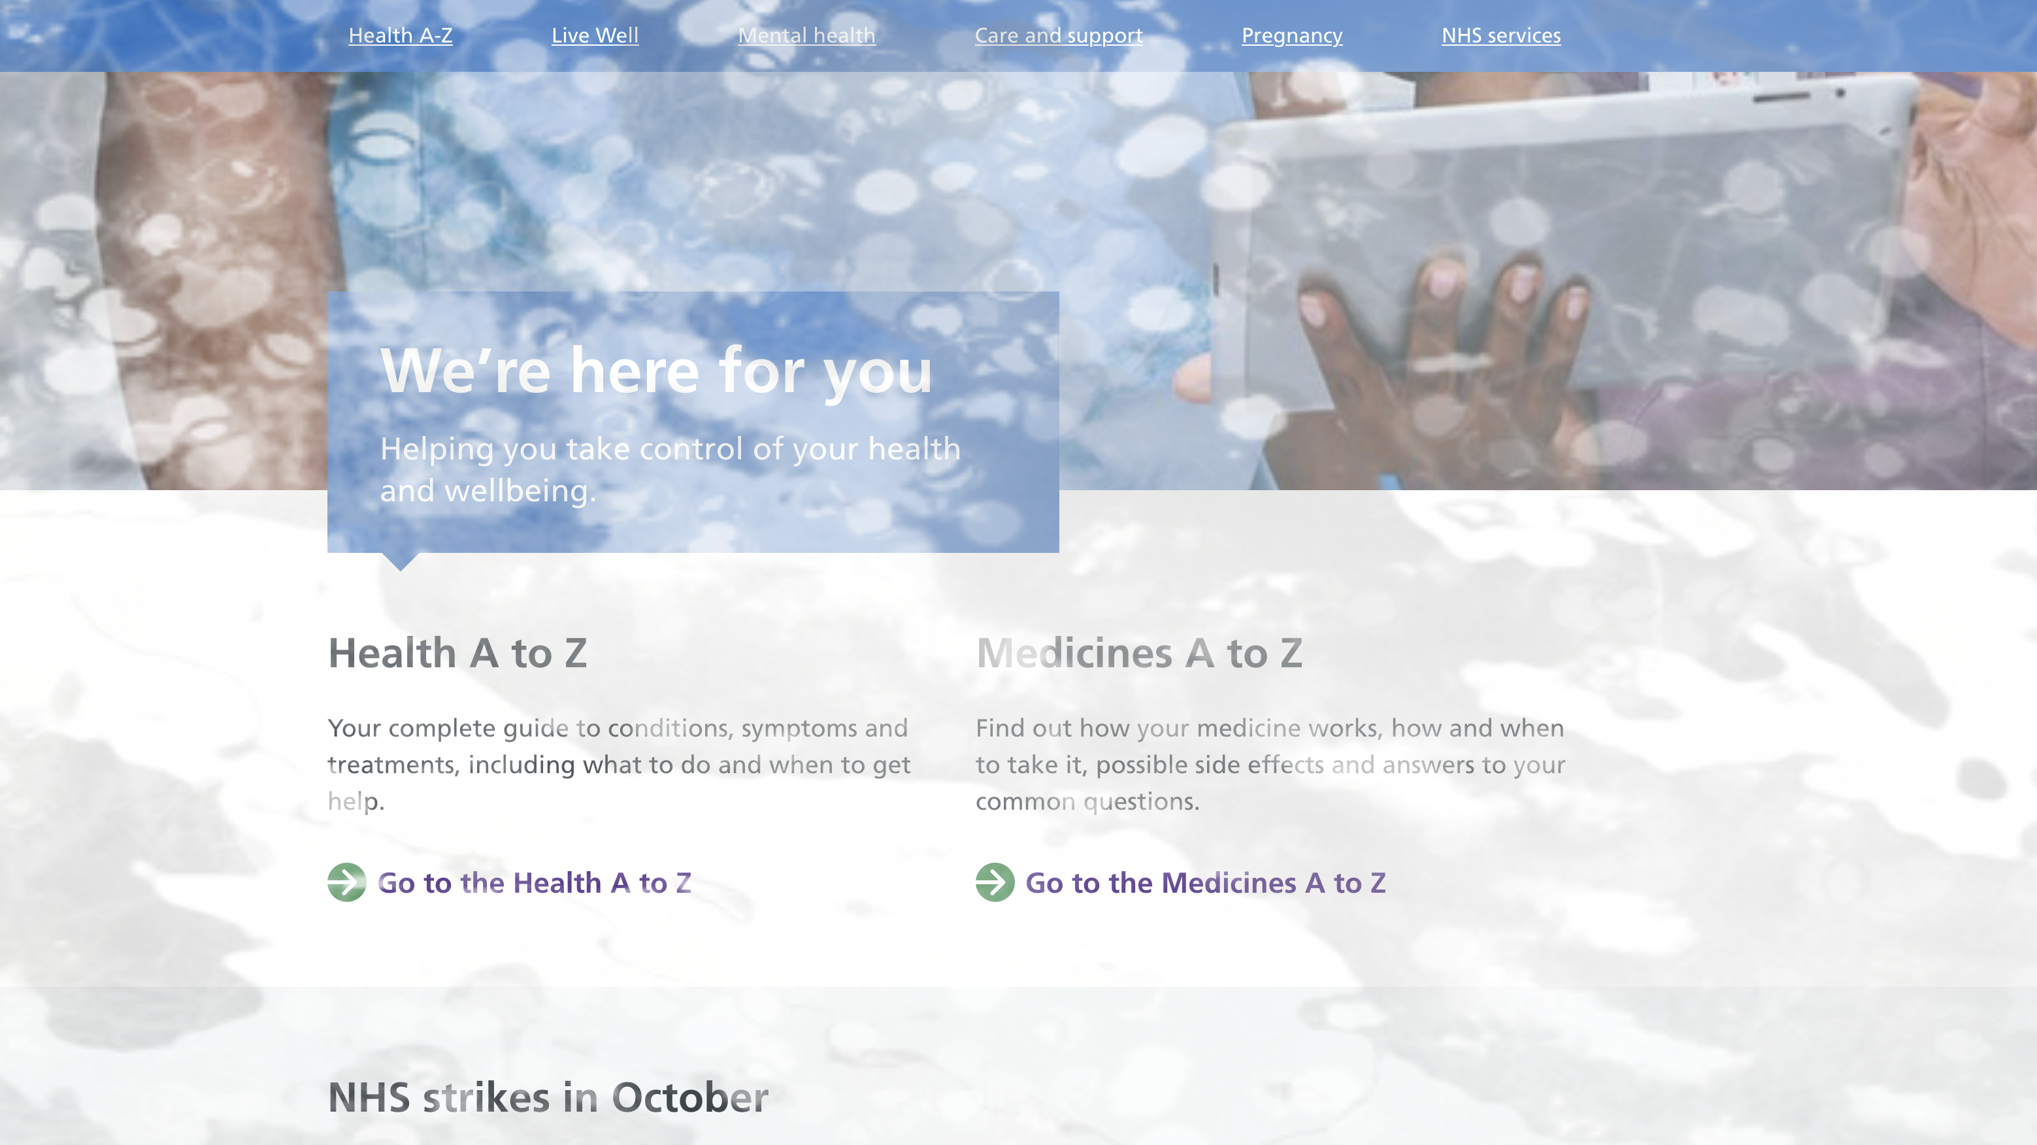
Image showing what cataracts might look like
Notes:
Cloudy patchy vision

Slide 14
Diabetic retinopathy
A complication of diabetes, caused by high blood sugar levels damaging the back of the eye (retina)
It can cause blindness if left undiagnosed and untreated. However, it usually takes several years for it to reach a stage where it could threaten your sight
Anyone with type 1 or type 2 diabetes is potentially at risk
Symptoms may include gradually worsening vision, sudden vision loss, shapes floating in your field of vision, blurred or patchy vision, eye pain or redness, difficulty seeing in the dark

Slide 15
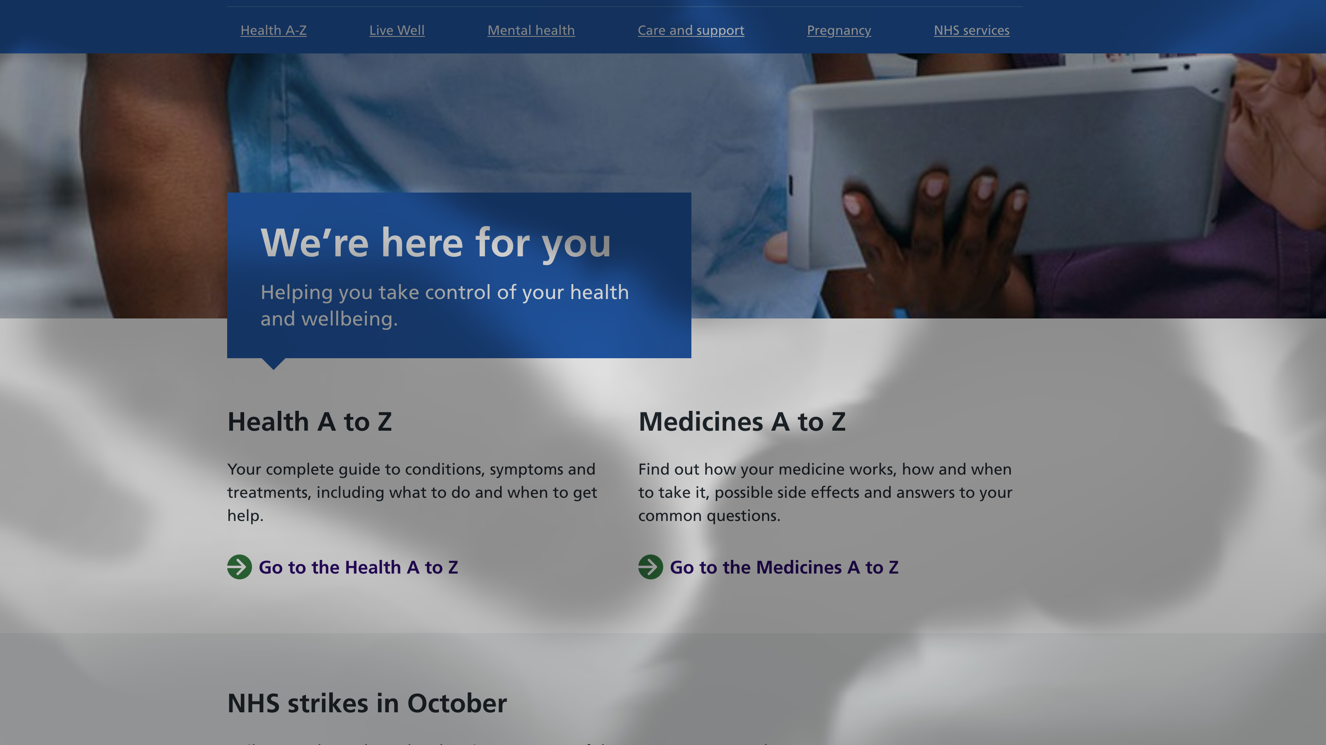
Image showing what diabetic retinopathy might look like
Notes:
Floating shapes

Slide 16
Glaucoma
A common condition where the optic nerve, which connects the eye to the brain, becomes damaged
Usually caused by fluid building up in the front part of the eye, which increases pressure inside the eye
It can lead to loss of vision if not diagnosed and treated early
It can affect people of all ages, but is most common in adults in their 70s and 80s
Tends to develop slowly over many years and affects the edges of your vision (peripheral vision) first

Slide 17
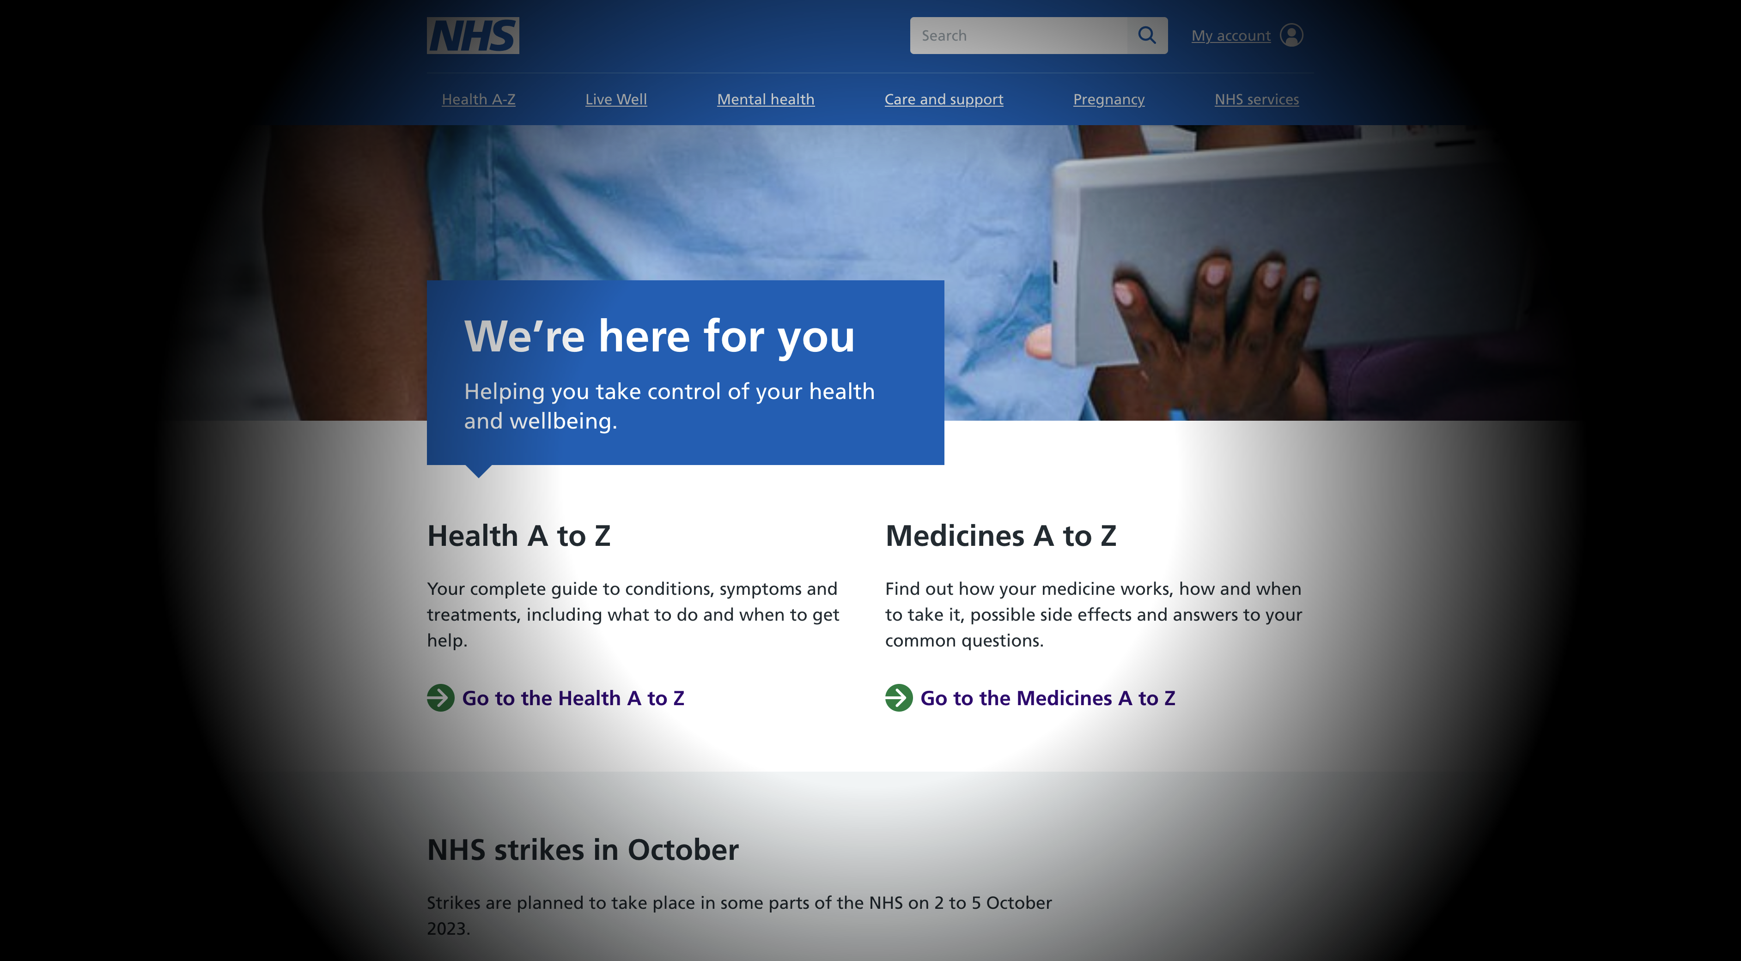
Image showing what glaucoma might look like
Notes:
Loss of peripheral vision

Slide 18

“About two thirds of people
have vision problems
after a stroke.”
Stroke Association
Notes:
A statistic from the Stroke association

Slide 19
Vision problems after stroke
Visual field loss - hemianopia
Eye movement problems
Visual processing problems
Dry eye
Light sensitivity
Visual hallucinations
Notes:
As you will be aware…
Visual field loss - hemianopia is the most common, losing the left or right half of the visual field of both eyes
Eye movement problems – problems with the fine nerve control of the muscles that move the eyes
Visual processing problems – brain having difficulties processing the information from the eyes and other senses, e.g., recognising objects, people, colours
Visual hallucinations – where the brain may generate images in the missing area of vision

Slide 20
Vine
Simulation Package
Notes:
Let’s have a look at the Vine Simulation Package

Slide 21
Who are VINE?
Visual Impairment North-East is a small independent charity.
They aim to improve the lives of visually impaired people through promoting greater understanding of eye conditions and problems faced by visually impaired people.
Notes:
VINE stands for Visual Impairment North East
They’ve been going since 1984 and they’ve made a simulation package, which includes some simulation spectacles

Slide 22
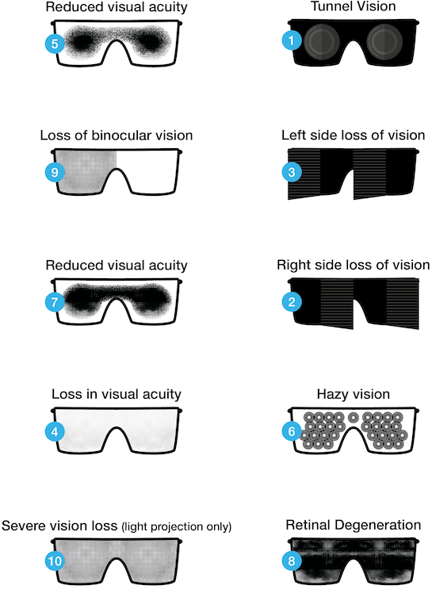
VINE spectacles
10 pairs of spectacles simulating the most common symptoms of the most common eye conditions
Notes:
Enables people to understand the varying visual problems of registered blind and partially sighted

Slide 23
The spectacles
Total loss of peripheral vision (tunnel vision)
Loss of half the visual field (right-sided hemianopia)
Loss of half the visual field (left-sided hemianopia)
Reduced clarity of vision (just below UK driving standard)
Loss of central vision (early stage)
Hazy vision with light scatter and glare
Loss of central vision (advanced stage)
Patchy vision
Light perception only in one eye and poor vision in the other
Light perception only in both eyes
Notes:
A detailed list of the glasses, simulating various symptoms as you can see

Slide 24
Disclaimer
The spectacles can only give some idea of what a visually impaired person may see
They are not meant to represent the view seen by any particular individual
They can help to identify some of the problems visually impaired people experience
An individual’s sight may fluctuate during the course of a day due to:
their general state of health
lighting conditions
decor
Notes:
A bit of a disclaimer…
It must be emphasised that the spectacles can only give some idea of what a visually impaired person may see…
We must remember that everyone is different

Slide 25
Getting to know the glasses
Exercises
Notes:
We have a few exercises and tasks that you can do, so let’s go have a look

Slide 26
End slide

